Slide 1
ADF understanding

Slide 2
outline

Slide 3
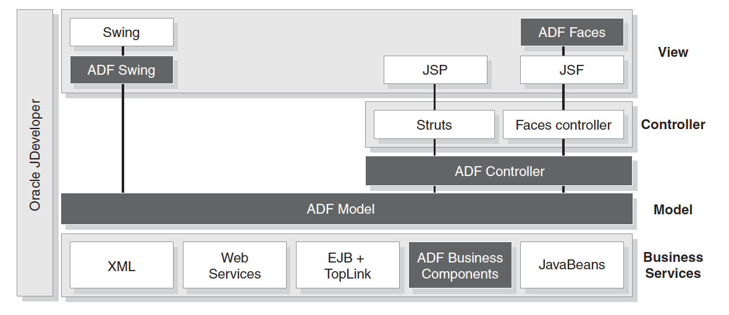
aDF overview

Slide 4
ADF Model
Oracle ADF Model, a declarative data binding
facility that implements the JSR-227 specification. The Oracle ADF Model layer enables a unified approach to bind any user interface to any business service with no code.

Slide 5
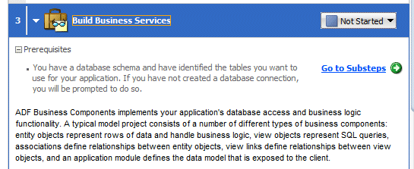
Business Components
Business logic ←→ database access
Entity object: rows of data and handle business logic → Associations
View object: SQL queries → View links
Application module: data model exposed to the client

Slide 6
ADF Controller： View Layer Technologies Supported
Oracle ADF Controller integrates Struts and JSF with Oracle ADF Model
Oracle ADF Struts offers a library of components for web applications built with JSP
Oracle ADF Faces offers a library of components for web applications built with JSF
Oracle ADF Swing extends Oracle ADF Model to desktop applications built with Swing
visual page flow diagrammers to design your page flow
appropriate plug-ins to integrate the ADF Model data binding facility with the controller layer’s page processing lifecycle

Slide 7
ADF Business Components
Oracle ADF Business Components simplifies building business services for developers familiar with 4GL tools like Oracle Forms.
Enterprise JavaBeans (EJB) Session Beans： EJB session beans offer declarative transaction control.
JavaBeans，plain old Java objects (POJOs) with TopLink
EJB entity beans to represent your business domain objects
Web Services: WSDL

Slide 8
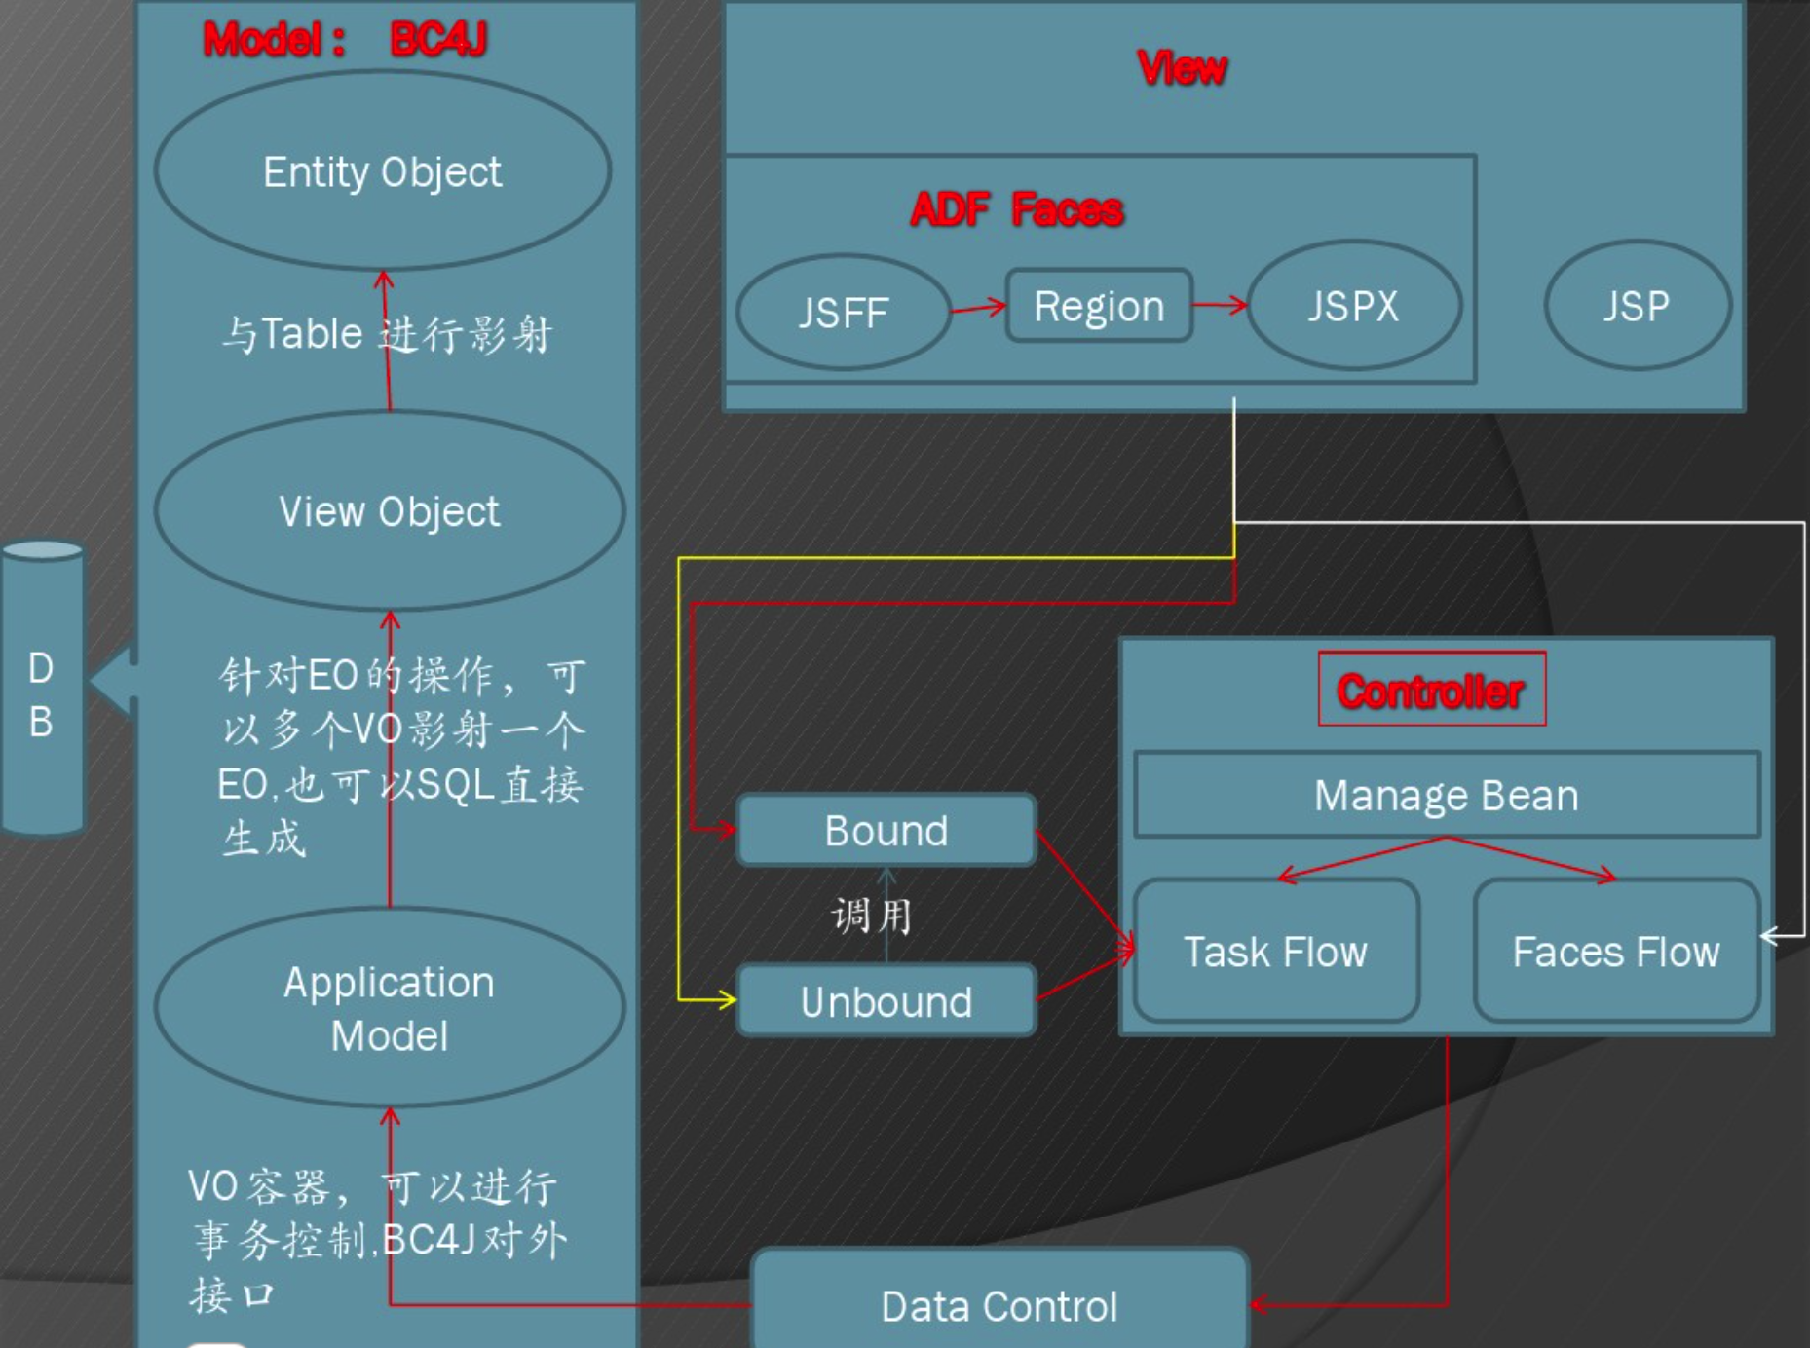
Entity Object & View Object

Slide 9
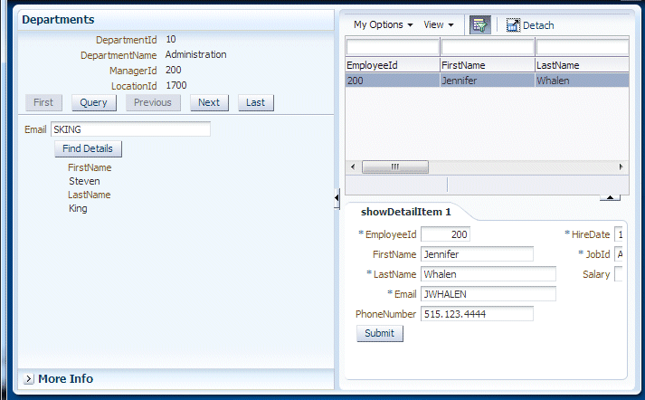
Create a new Fusion Web app

Slide 10
Create a new Fusion Web app

Slide 12
